Slide 1
Outline
Review: TTL-based Solution
Problems Caused by The TTL-based Solution
PFC Headroom is Too Large
Per Flow Fairness Will be Violated

Slide 2
Outline
Review: TTL-based Solution
Problems Caused by The TTL-based Solution
PFC Headroom is Too Large
Per Flow Fairness Will be Violated

Slide 3
Review: A Solution for All Kinds of Deadlocks
Routing induced deadlock
Routing function includes cyclic buffer dependency.
Solution: deadlock-free routing algorithm.
Reconfiguration induced deadlock
Cyclic buffer dependency is created during routing reconfiguration.
Solution: deadlock-free routing reconfiguration.
Failure induced deadlock
Routing protocols like BGP can have transient loop under failures which may cause deadlock.
Solution: deadlock-free BGP.
Bug or misconfiguration induced deadlock.
Solution: fix the bug or misconfiguration.
It is more desired to have a single solution for handling all the deadlocks.

Slide 4
Review: Key idea of TTL-base Solution
Divide switch buffer into n partitions of n priority classes.
Assign a priority to a packet based on the TTL value of the packet at each hop. TTL value of a packet will decrease by 1 per hop. We increase the priority of a packet by 1 per hop, correspondingly.
Class n
Class n
…
…
Class k +1
Class k
…
…
packet
Class 2
Class 2
Class 1
Class 1
Switch buffer
Switch buffer
Switch at hop k
Switch at hop k+1

Slide 5
Review: Key idea of TTL-base Solution
TTL-based solution can prevent all kinds of deadlock as it can eliminate cyclic buffer dependency.
Cyclic buffer dependency without BMS.
Cyclic buffer dependency without BMS.
Topology and flows

Slide 6
Review: Switch Model
The switch model consists of five elements: switch port, forwarding engine, PFC engine, crossbar and switch buffer.

Slide 7
Review: TTL-based Solution
Buffer Division:
Divide switch buffer into k partitions, and let the j-th partition associated with priority class j.
If a packet is classified into priority class j, it will be buffered in the j-th buffer partition.
TTL-based Packet Buffering:
Initially, we set TTL values of all the packets to ttl₀ = d at all the source servers, where d is the number of hops of the longest path in the network.
Let ttl_{i} be the TTL value of a packet p at its i-th hop (i ≥ 0). At every hop, the priority class of any incoming packet p is calculated as λ_{p} = ttl₀ − ttl_{i}.

Slide 8
Dedicated Buffer for Different Priorities Is Necessary
If we do not reserve dedicated buffer for every priority class, there can still be deadlock.
Topology and flows
No cyclic dependency among priority queues
Cyclic buffer waiting

Slide 9
Review: Alternative Way To Do Buffer Division
Alternative Buffer Division:
divide the switch buffer into k+1 partitions. The first k partitions are dedicated for the k priority classes. The k+1 partition is shared by all the priority classes.
During runtime, a packet of priority class j will always use its dedicated buffer before use the shared buffer.

Slide 10
Outline
Review: TTL-based Solution
Problems Caused by The TTL-based Solution
PFC Headroom is Too Large
Per Flow Fairness Will be Violated

Slide 11
Calculation of PFC Headroom
Let t₁ be the time a receiver decides to stop the data transmission of an immediate upstream device.
Let t₂ be the time the sender has stopped the data transmission and there are no bytes of packets remaining on the wire.
PFC headroom is the size of buffer the receiver must reserve to accommodate the packets it may receive during [t₁, t₂].
Buffer
Sender
Receiver
data packet from sender to receiver
data packet from receiver to sender
PFC message

Slide 12
Calculation of PFC Headroom
Notations:
s_{MTU} | Value of maximum transmission unit (typically 1500bytes).
S_{min} | Value of minimum transmission unit (typically 64bytes).
S_{PFC} | Size of PFC control message.
S_{cell} | Size of buffer cell.
S_{p} | Size of packet p.
r_{l} | Line rate of network links.

Slide 13



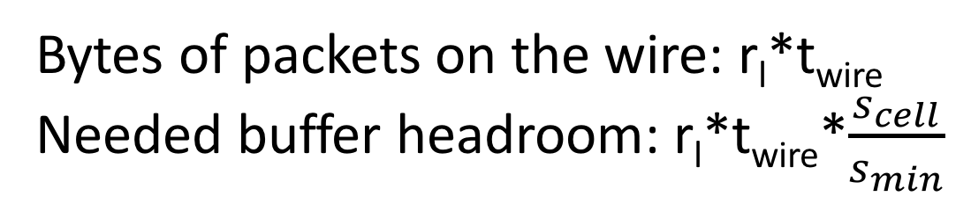
Calculation of PFC Headroom
1. Buffer headroom for buffering packets already on the wire right before the receiver decides to send a PAUSE message (denoted as t_{wire}): t_{wire} is the propagation delay of the network link.
Bytes of packets on the wire: r_{l}*t_{wire}
Needed buffer headroom: r_{l}*t_{wire}*$\frac{s_{cell}}{s_{min}}$
$$s_{min}$$
$$s_{min}$$
$$s_{min}$$
$$s_{min}$$
Buffer
Sender
Receiver

Slide 14
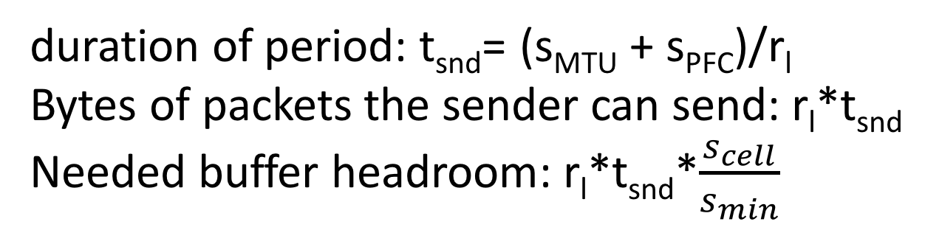
Calculation of PFC Headroom
2. Buffer headroom for buffering packets sent by the sender during the period the receiver sends out a PAUSE message (denoted as t_{snd}):
duration of period: t_{snd}= (s_{MTU} + s_{PFC})/r_{l}
Bytes of packets the sender can send: r_{l}*t_{snd}
Needed buffer headroom: r_{l}*t_{snd}*$\frac{s_{cell}}{s_{min}}$
$$s_{min}$$
$$s_{min}$$
$$s_{min}$$
$$s_{min}$$
Buffer
Sender
Receiver

Slide 15
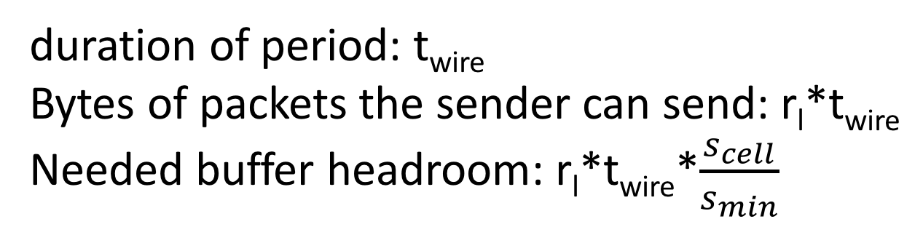
Calculation of PFC Headroom
3. Buffer headroom for buffering packets sent by the sender during the period when the PAUSE message propagates from the receiver to the sender (denoted as t_{wire}):
duration of period: t_{wire}
Bytes of packets the sender can send: r_{l}*t_{wire}
Needed buffer headroom: r_{l}*t_{wire}*$\frac{s_{cell}}{s_{min}}$
$$s_{min}$$
$$s_{min}$$
$$s_{min}$$
$$s_{min}$$
Buffer
Sender
Receiver

Slide 16
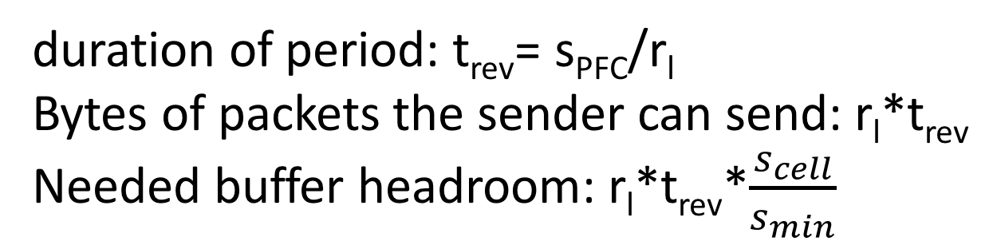
Calculation of PFC Headroom
4. Buffer headroom for buffering packets sent by the sender during the period the sender to receive the PAUSE message. (denoted as t_{rev}).
duration of period: t_{rev}= s_{PFC}/r_{l}
Bytes of packets the sender can send: r_{l}*t_{rev}
Needed buffer headroom: r_{l}*t_{rev}*$\frac{s_{cell}}{s_{min}}$
$$s_{min}$$
$$s_{min}$$
$$s_{min}$$
$$s_{min}$$
Buffer
Sender
Receiver

Slide 17
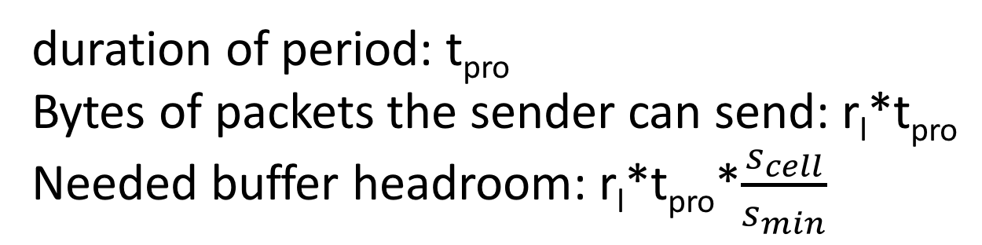
Calculation of PFC Headroom
5. Buffer headroom for buffering packets sent by the sender during the period the sender processes the PAUSE message (denoted as t_{pro}):
duration of period: t_{pro}
Bytes of packets the sender can send: r_{l}*t_{pro}
Needed buffer headroom: r_{l}*t_{pro}*$\frac{s_{cell}}{s_{min}}$
$$s_{min}$$
$$s_{min}$$
$$s_{min}$$
$$s_{min}$$
Buffer
Sender
Receiver

Slide 18
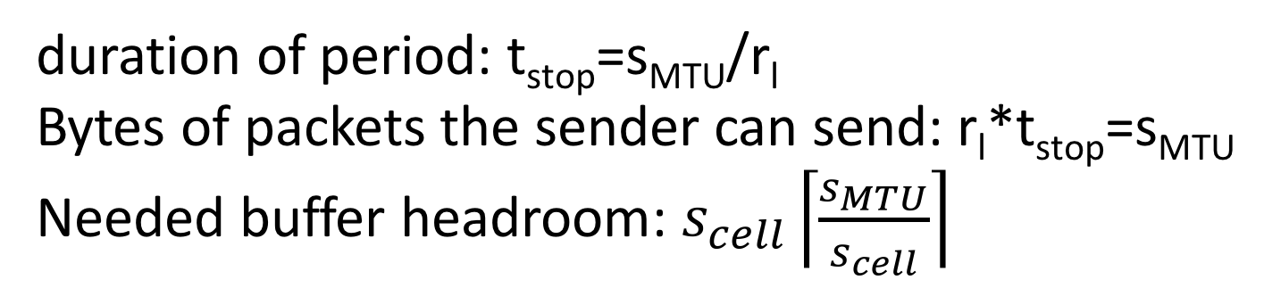




Calculation of PFC Headroom
6. Buffer headroom for buffering packets sent by the sender during the period the sender stops packet transmission (denoted as t_{stop}):
duration of period: t_{stop}=s_{MTU}/r_{l}
Bytes of packets the sender can send: r_{l}*t_{stop}=s_{MTU}
Needed buffer headroom: $s_{cell}\left\lceil \frac{s_{MTU}}{s_{cell}}\right\rceil$
$$s_{MTU}$$
$$s_{min}$$
$$s_{min}$$
$$s_{min}$$
$$s_{min}$$
Buffer
Sender
Receiver

Slide 19
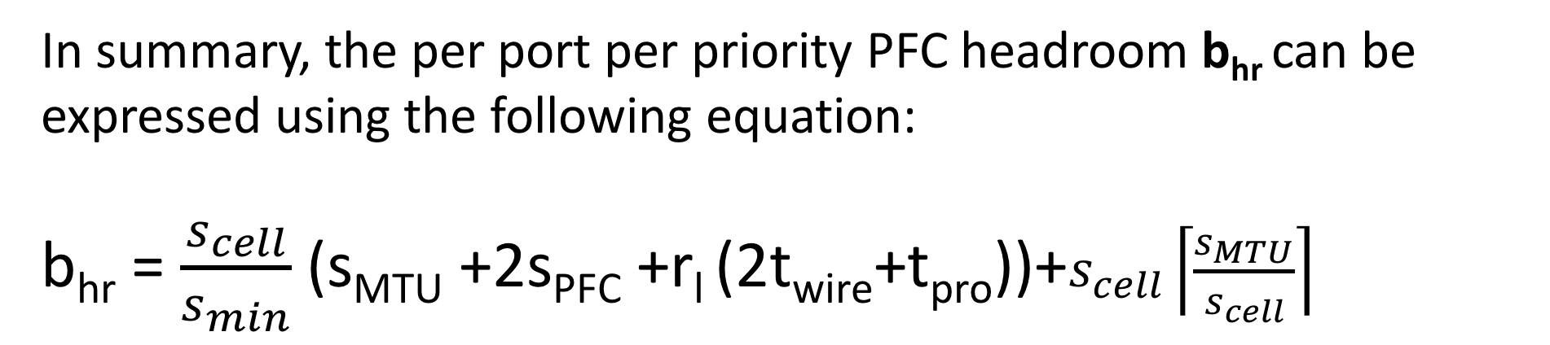
Calculation of PFC Headroom
In summary, the per port per priority PFC headroom b_{hr} can be expressed using the following equation:
b_{hr} = $\frac{s_{cell}}{s_{min}}$(s_{MTU} +2s_{PFC} +r_{l} (2t_{wire}+t_{pro}))+$s_{cell}\left\lceil \frac{s_{MTU}}{s_{cell}}\right\rceil$

Slide 20
Typical Values of Variables In The Equation
For typical TCP/IP based RDMA DCNs, we have s_{MTU} = 1500bytes, s_{min} = 64bytes, s_{PFC} = 64bytes.
For Broadcom chipset, we have s_{cell}=208bytes.
Every 100 meters of link delays the reception of a packet by about 500ns for copper cables. The length of links used in a single DCN is usually no larger than 300 meters. Hence we have t_{wire} ≤ 1.5us.
According to the data from Chuanxiong, we have t_{pro} ≤ 4us.

Slide 21
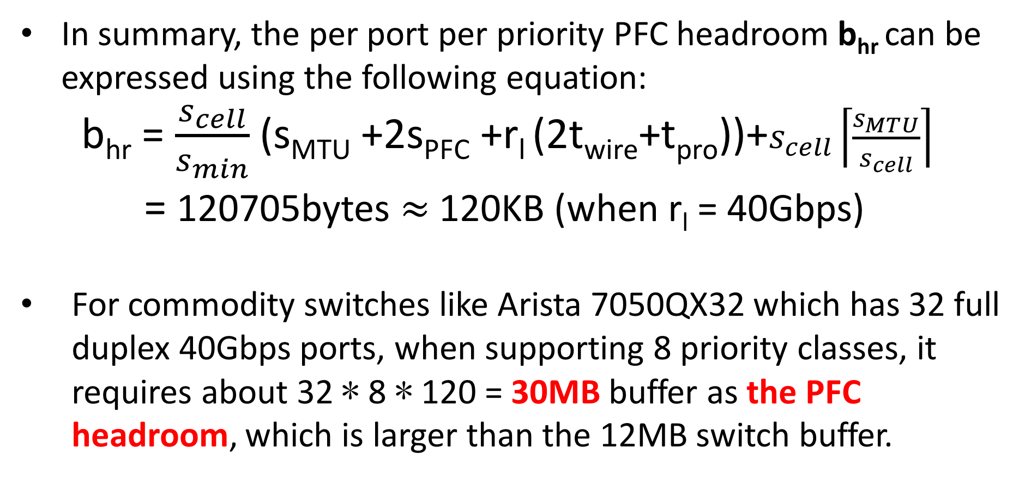
Calculation of PFC Headroom
In summary, the per port per priority PFC headroom b_{hr} can be expressed using the following equation:
b_{hr} = $\frac{s_{cell}}{s_{min}}$(s_{MTU} +2s_{PFC} +r_{l} (2t_{wire}+t_{pro}))+$s_{cell}\left\lceil \frac{s_{MTU}}{s_{cell}}\right\rceil$
= 120705bytes $≈$ 120KB (when r_{l} = 40Gbps)
For commodity switches like Arista 7050QX32 which has 32 full duplex 40Gbps ports, when supporting 8 priority classes, it requires about 32 ∗ 8 ∗ 120 = 30MB buffer as the PFC headroom, which is larger than the 12MB switch buffer.

Slide 22
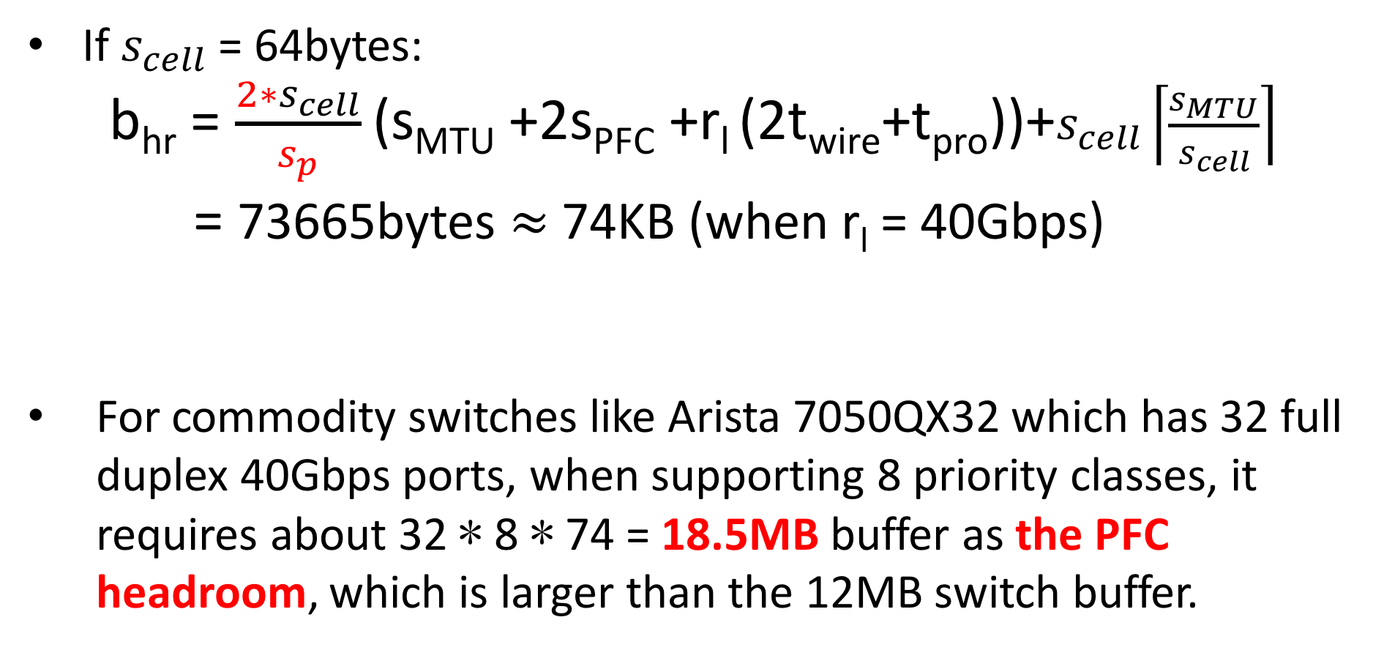

Using Smaller Buffer Cell Can Help
If $s_{cell}$ = 64bytes:
b_{hr} = $\frac{{2∗s}_{cell}}{s_{p}}$(s_{MTU} +2s_{PFC} +r_{l} (2t_{wire}+t_{pro}))+$s_{cell}\left\lceil \frac{s_{MTU}}{s_{cell}}\right\rceil$
= 73665bytes $≈$ 74KB (when r_{l} = 40Gbps)
For commodity switches like Arista 7050QX32 which has 32 full duplex 40Gbps ports, when supporting 8 priority classes, it requires about 32 ∗ 8 ∗ 74 = 18.5MB buffer as the PFC headroom, which is larger than the 12MB switch buffer.
$s_{cell}$ = 64bytes, s_{p}=65bytes

Slide 23
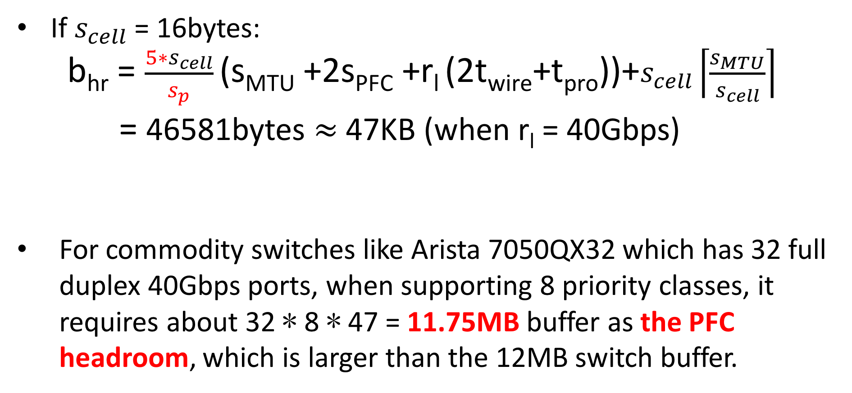

Using Smaller Buffer Cell Can Help
If $s_{cell}$ = 16bytes:
b_{hr} = $\frac{{5∗s}_{cell}}{s_{p}}$(s_{MTU} +2s_{PFC} +r_{l} (2t_{wire}+t_{pro}))+$s_{cell}\left\lceil \frac{s_{MTU}}{s_{cell}}\right\rceil$
= 46581bytes $≈$ 47KB (when r_{l} = 40Gbps)
For commodity switches like Arista 7050QX32 which has 32 full duplex 40Gbps ports, when supporting 8 priority classes, it requires about 32 ∗ 8 ∗ 47 = 11.75MB buffer as the PFC headroom, which is larger than the 12MB switch buffer.
$s_{cell}$ = 16bytes, s_{p}=65bytes

Slide 24
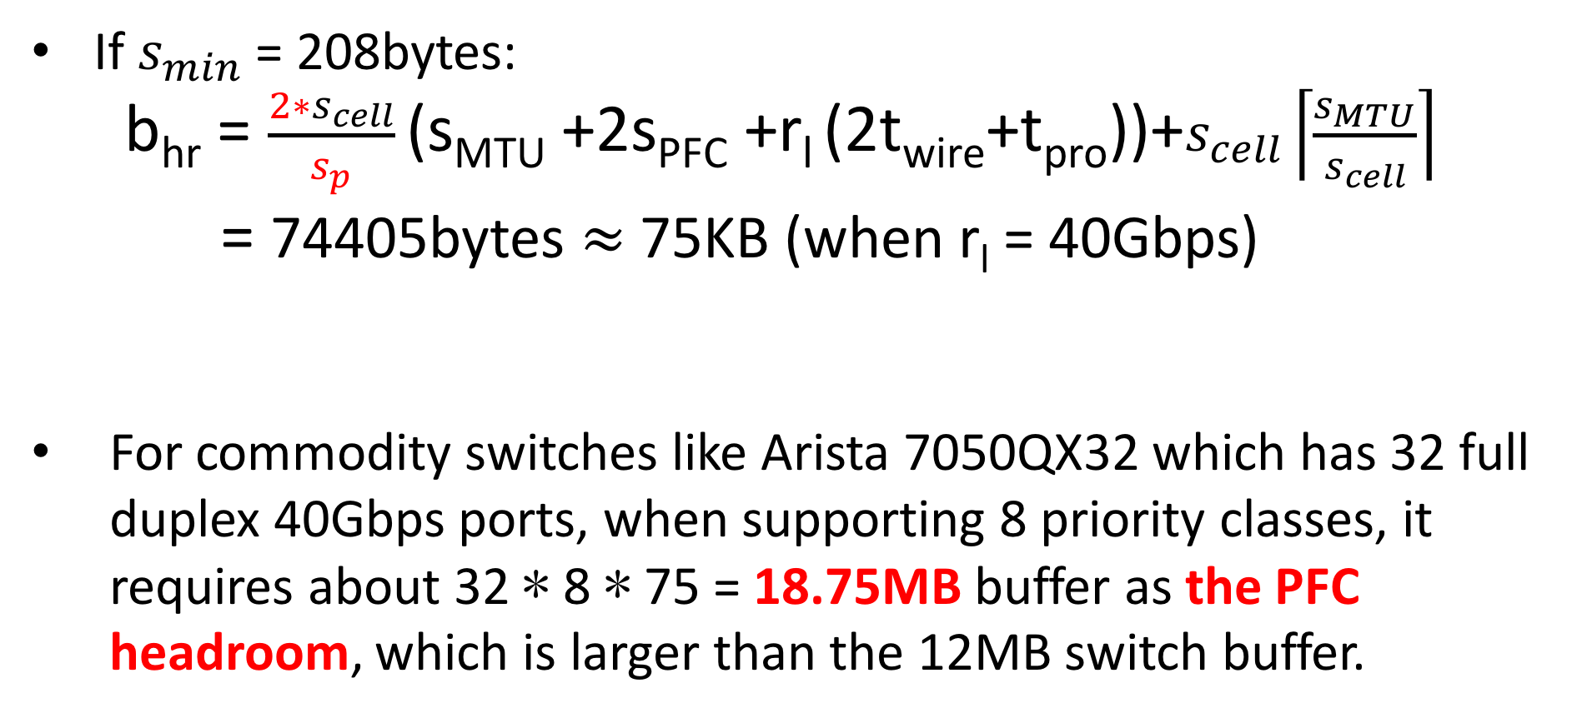

Increasing The Size of Minimum Packet Can Help
If $s_{min}$ = 208bytes:
b_{hr} = $\frac{2∗s_{cell}}{s_{p}}$(s_{MTU} +2s_{PFC} +r_{l} (2t_{wire}+t_{pro}))+$s_{cell}\left\lceil \frac{s_{MTU}}{s_{cell}}\right\rceil$
= 74405bytes $≈$ 75KB (when r_{l} = 40Gbps)
For commodity switches like Arista 7050QX32 which has 32 full duplex 40Gbps ports, when supporting 8 priority classes, it requires about 32 ∗ 8 ∗ 75 = 18.75MB buffer as the PFC headroom, which is larger than the 12MB switch buffer.
$s_{cell}$ = 208bytes, s_{p}=209bytes

Slide 25
Reducing Number of Priorities Needed by The TTL-based Solution
…
…
…
…
Assuming at all source servers, initial TTL value of all packets are set to ttl₀ (a even number).

Slide 26
Reducing Number of Priorities Needed by The TTL-based Solution
TTL = ttl₀-3-2k
TTL = ttl₀-2-2k
TTL = ttl₀-1-2k
…
…
…
…
TTL = ttl₀-2k
Assuming at all source servers, initial TTL value of all packets are set to ttl₀ (a even number).

Slide 27
Reducing Number of Priorities Needed by The TTL-based Solution
TTL = ttl₀-3-2k
TTL = ttl₀-2-2k
TTL = ttl₀-1-2k
…
…
…
…
TTL = ttl₀-2k
Observation: switches at the same layer only need to support either all the even priority or all the odd priority.

Slide 28
Reducing Number of Priorities Needed by The TTL-based Solution
Priority: 1 3 5
Priority: 2 4 6
Priority: 1 3 5 7
Priority: 0 2 4 6 8
…
…
…
…
For Arista 7050QX32 switch, the PFC headroom can be reduced to a half. When S_{cell} = 208bytes, b_{hr} =15MB. When S_{cell} = 16bytes, b_{hr} =5.875MB.

Slide 29
Outline
Review: TTL-based Solution
Problems Caused by The TTL-based Solution
PFC Headroom is Too Large
Per Flow Fairness Will be Violated

Slide 30
Per Flow Fairness Under TTL-based Solution
B
f3
f1
f2
…
…
…
…
H1
H2
H3
H4
We consider three flows f1, f2 and f3 from hosts H2, H3 and H4 to H1, respectively.

Slide 31
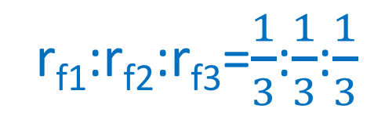
Per Flow Fairness Under TTL-based Solution
r_{f1}:r_{f2}:r_{f3}=$\frac{1}{3}$:$\frac{1}{3}$:$\frac{1}{3}$
B
f1
f2
f3
f3
f1
f2
…
…
…
…
H1
H2
H3
H4
Without applying the TTL-based solution, there is only one queue. Ideally, each flow should share 1/3 bandwidth at the bottleneck link.

Slide 32
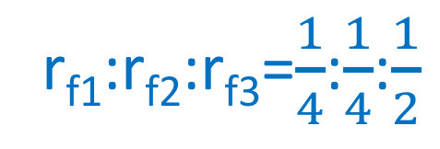
Per Flow Fairness Under TTL-based Solution
B
r_{f1}:r_{f2}:r_{f3}=$\frac{1}{4}$:$\frac{1}{4}$:$\frac{1}{2}$
f1
f2
f3
f3
f1
f2
…
…
…
…
W_{q1}:W_{q2}=1:1
H1
H2
H3
H4
With the TTL-based solution, f1 and f2 will share a common queue, while f3 will enter a different queue. This introduces flow unfairness among three flows.

Slide 33
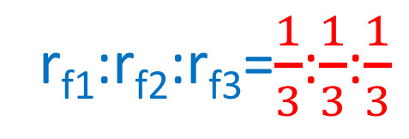
Per Flow Fairness Under TTL-based Solution
B
r_{f1}:r_{f2}:r_{f3}=$\frac{1}{3}$:$\frac{1}{3}$:$\frac{1}{3}$
f1
f2
f3
f3
f1
f2
…
…
…
…
W_{q1}:W_{q2}=2:1
H1
H2
H3
H4
We can reserve per flow fairness by dynamically change the weight of different queues. This requires the switch to maintain per flow state, which is too expensive.

